Slide 1

Dealing with Conflict 2026

Slide 2
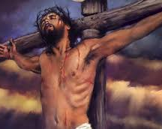
Spiritual discipline with conflict
‘But I tell you, love your enemies and pray for those who persecute you
that you may be children of your Father in heaven…’ - Matt 5:45,46
e.g. Ask God to
  lead them toward the Light
  help them grow
  heal what’s broken in them
  bless them

Slide 3
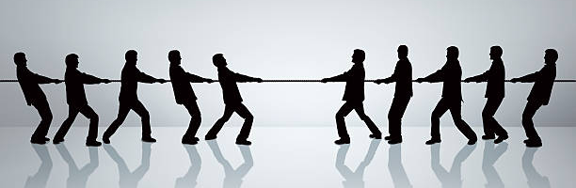
Conflict is Normal
Communication
Vision &
direction
Leadership
Personality clashes
Governance
Finances
Resistance
to change
Power struggles
Theology

Slide 4
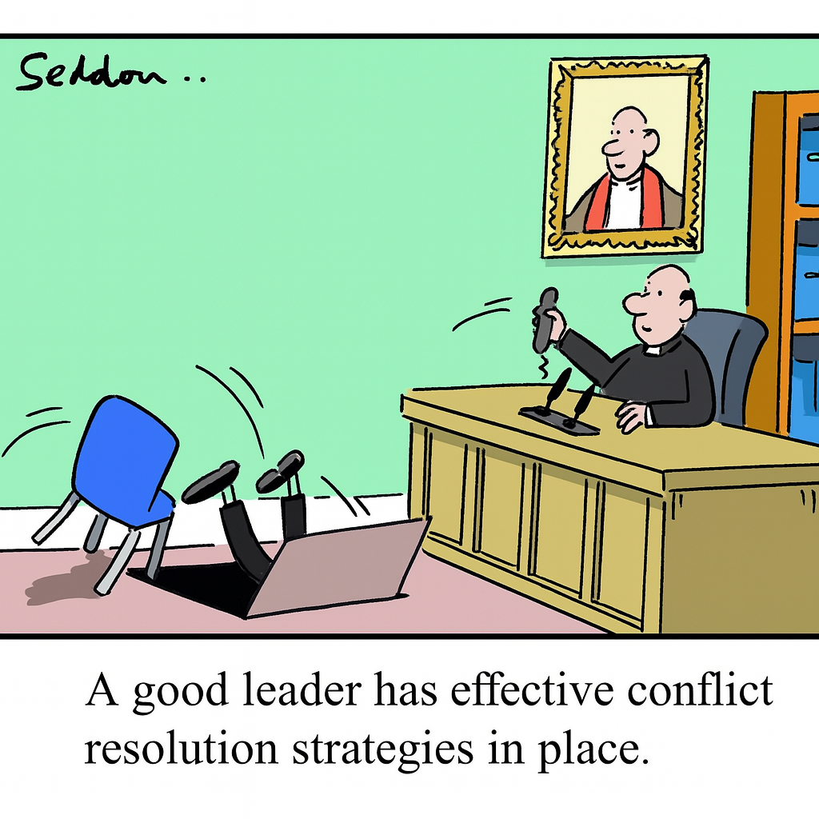

Slide 5

‘Growing up into the fullness of the stature of Christ’
Eph 4:13
includes our capacity to love our enemies
deal with conflict, vital for healthy relationships & effective ministries

Slide 6
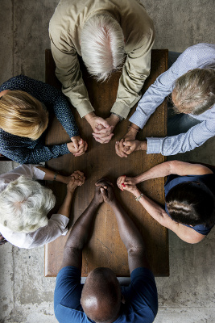
Benefits
Less stress
More authentic relationships
Safety across wider range of relationship
Greater vitality in our groups
Robust loving community
Resilience against forces of darkness
More effective mission in our communities

Slide 7
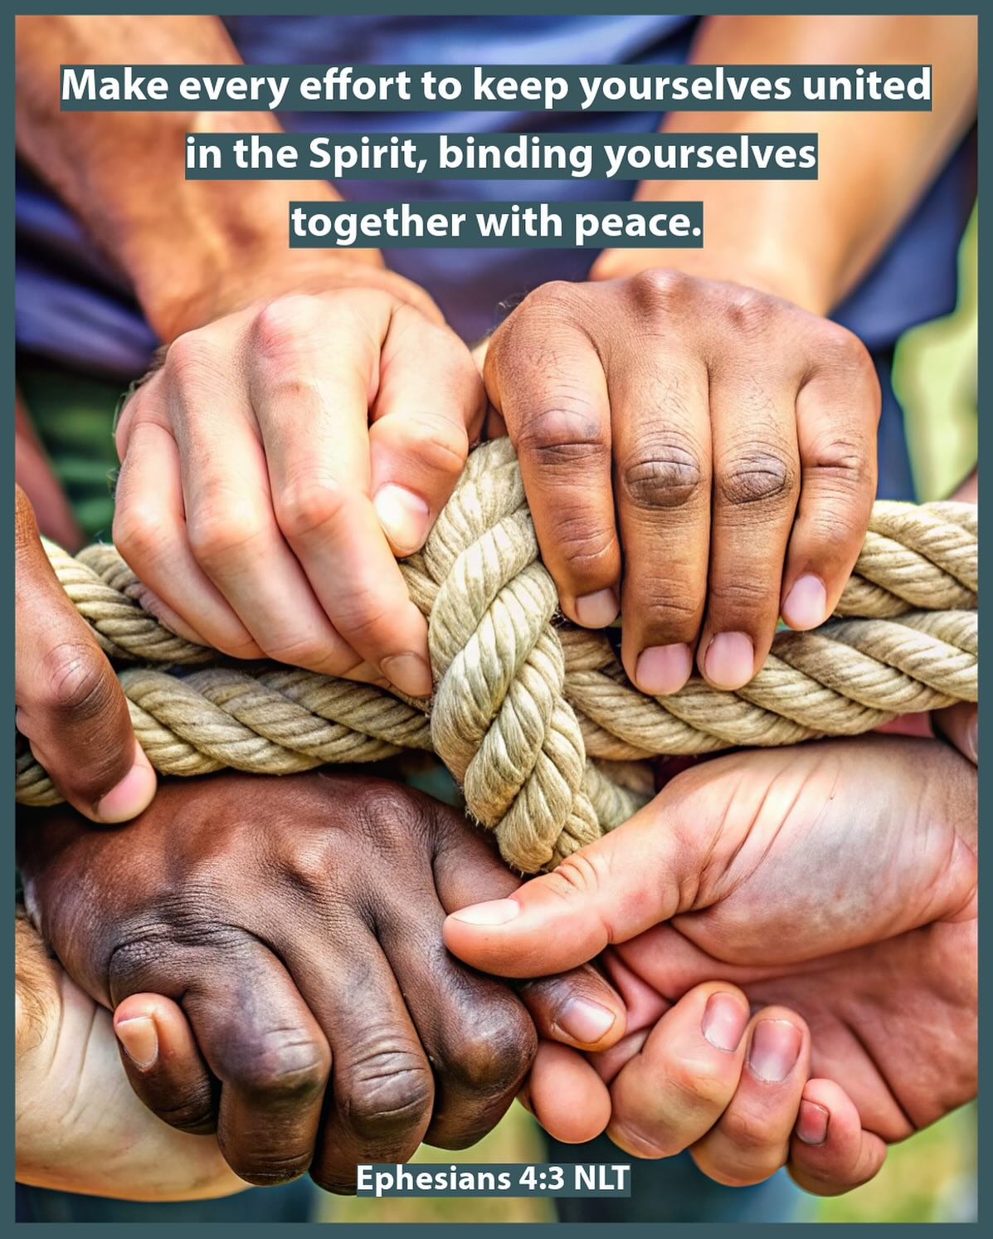
It takes effort
‘Make every effort to keep the unity of the spirit through the bond of peace.’ - Eph 4: 23

Slide 8
Deeper Unity
conflict resolved
robust, more effective ministry
Superficial ‘unity’
conflict avoided
more fragile
Conflict
creative
tension

Slide 9
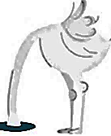


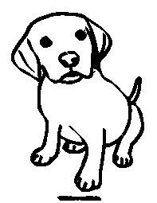
Natural responses to conflict
Fight/flight --- Freeze --- Tend-and-befriend
Avoiding
Attacking Negotiating/resolving Pleasing

Slide 10
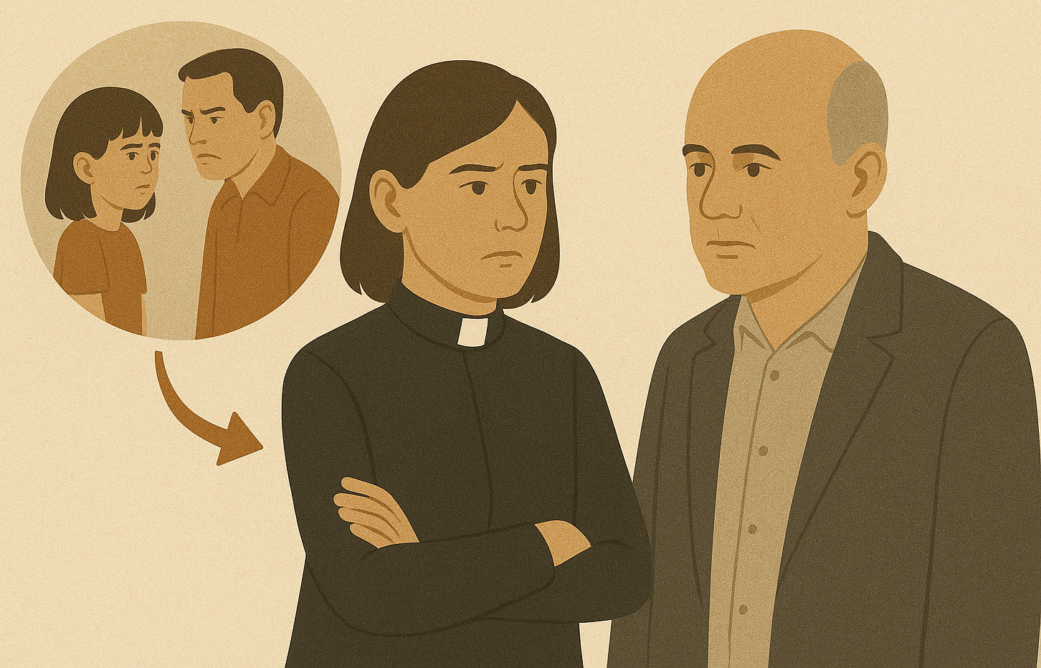
Transference
The transfer of thoughts & emotions from
past relationships into the present.
esp negative transferences
Alert: response is excessively emotional /strong negative thoughts
interfering with a healthy, mature, free interaction.
Question: Who does this remind me of, as far back as I can remember?

Slide 11

Becoming more like Jesus dealing with conflict
Orientation of love (agape) means
  Curiosity, quick to listen, slow to speak.... Jas 1:19
  Speak the truth in love Eph 4:15
  Love our enemies and pray; forgive Matt 5:44, 6:14-15

Slide 12
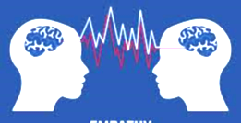
Rules of engagement
Bring conflict into the open by asking permission.
Address power dynamic – “We all make mistakes, me too.”
Two people equally present – each person’s ideas & concerns listened to.
Agree as much as possible before disagreeing.
Connect through empathy not collusion.
‘I’ statements vs ‘you’ statements: “I feel...” “I am concerned that....”
Appeal to wider authority: elders, “Churches usually…”, “Normal practice…”
Apologise if needed.
‘

Slide 13
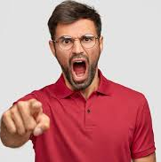
When severely criticised
1st position. It’s all about them.
This gives you space to think!
What is there about them that might cause them to react to me this way?
2nd position. Is it about me? While holding onto myself and my point of view,
‘Is there a degree of truth in the criticism I need to consider?’

Slide 14
Common Conflicts: Group Dynamics
Associative flow: “I notice we’ve moved off topic. Let’s come back to...”
Person talking too much: hold /validate / “What do others think?”
“(name), can I hold (stop) you there? You’ve got alot of good thoughts about this. What do others think?”
Actively invite unspoken disagreements (energy). Embrace ‘creative tension’: “Sometimes it’s hard to disagree when it seems everyone is thinking the same way. but it’s very important for us to hear any disagreements. Who has a different point of view?”

